Slide 1

Introduction to Macroecological Data Analysis in R
Macroecology & Community Ecology 2014
Week 38

Slide 2

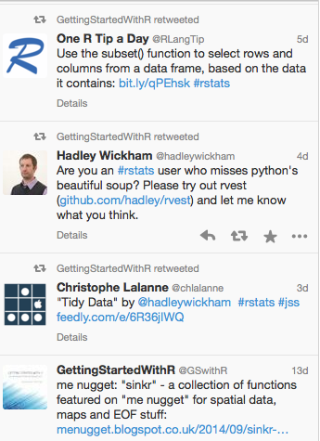
Getting Started with R @GSwithR

Slide 3
Why use R?
Open source
Free, cross-platform: you will never have to learn another piece of software!
Collaboration easy
Links to many other programmes
Reproducible & transparent analyses
Flexible command line language
Publication quality figures

Slide 4
Open Science
Increasing move toward transparency and reproducibility
Many of us use publicly available data
So all analyses can (and should!) be transparent and reproducible
Code can (and should!) be available online, sometimes as it is being developed
Github provides a way to do this, also tracks your changes (“version control”)

Slide 5
Don’t panic!
Today you will learn how to:
Read in data
Manipulate data
Visualize data
Run basic statistics
You will not learn how to do everything – it takes time & practice
Imagine it as a learning a new language

Slide 6
Think of R as a programming language with lots of statistics functions, not as a statistics package
…because you can do a LOT more with it
Create your own null models
Write and run simulation models
Draw, manipulate & analyze maps
Order pizza

Slide 7
R uses an Object-oriented language
R works by using objects
e.g., dataframe, matrix, vector
Objects are made up of elements
Object
Assign
Vector
x <- c(1,5,4,6,7,2)

Slide 8
We can then manipulate objects
Functions are like choosing from the menu in a drop down list but you type it yourself
Arguments within the functions are like click boxes in a drop down list
mean(x)
[1] 4.166667
sum(x)
[1] 25
Function
Argument

Slide 9
Hashtags & annotation
Anything with a hashtag is ignored by R
# this is just a note
You should always write notes around your code using hashtags
We have done this in the exercises you will be given to help you understand the code

Slide 10
Let’s have a look at R & R Studio

Slide 11
Errors are normal
You will get errors, these are normal
“Debugging” = identifying the bits of code that are producing errors and fixing them
Debugging is an essential part of R
d <- c(1,2,3,4,5,6))
Error: unexpected ')' in "d <- c(1,2,3,,4,5,6))

Slide 12
Report
Your report will include 4 elements:
The script of all your commands from today
Plot of richness against latitude
Scatterplots of relationships between environmental variables
Results of a linear regression model
Look out for markers:
############################################################
####### FOR YOUR REPORT 1 ######
####### START ######
############################################################
## ……..information on what you need to do…
############################################################
####### FOR YOUR REPORT 1 ######
####### END ######
############################################################

Slide 13
Exercise 1
Data manipulation
To practice handling data, we will look at simple examples so you can see what’s going on and get a feel for what R can do.
In the next exercise we will start to use real macroecological data.
R as a calculator
Create and manipulate vectors
Dataframe manipulation

Slide 14
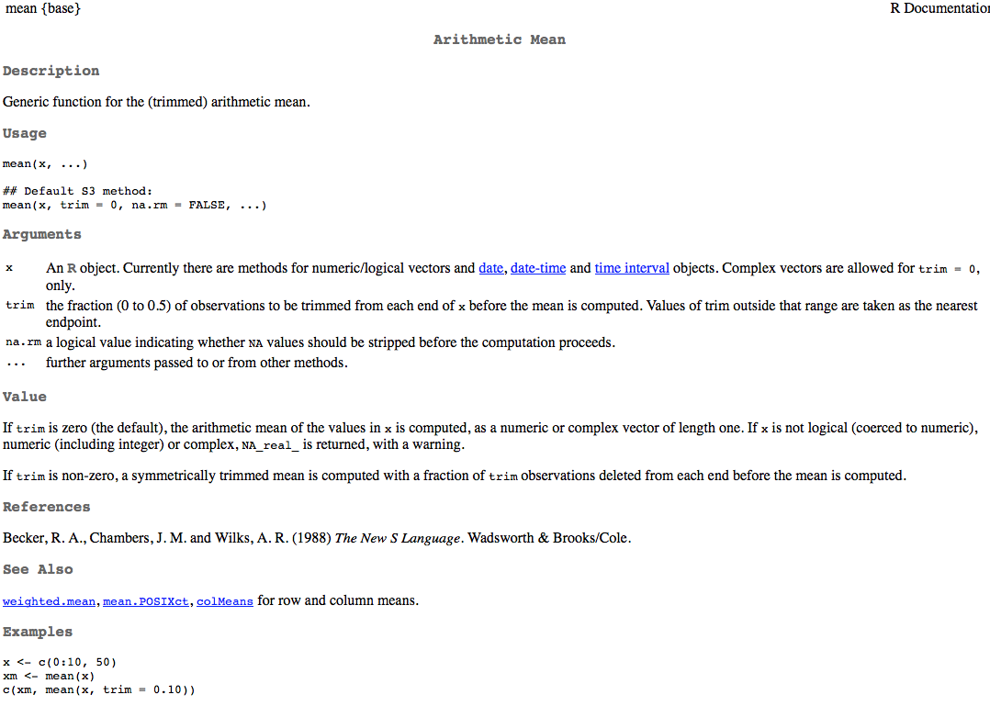
?mean

Slide 15
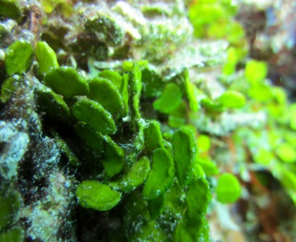
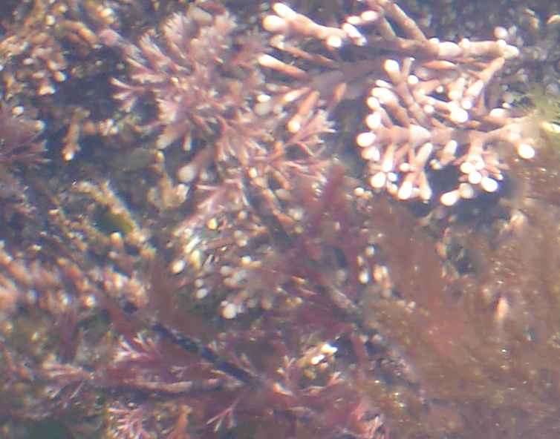
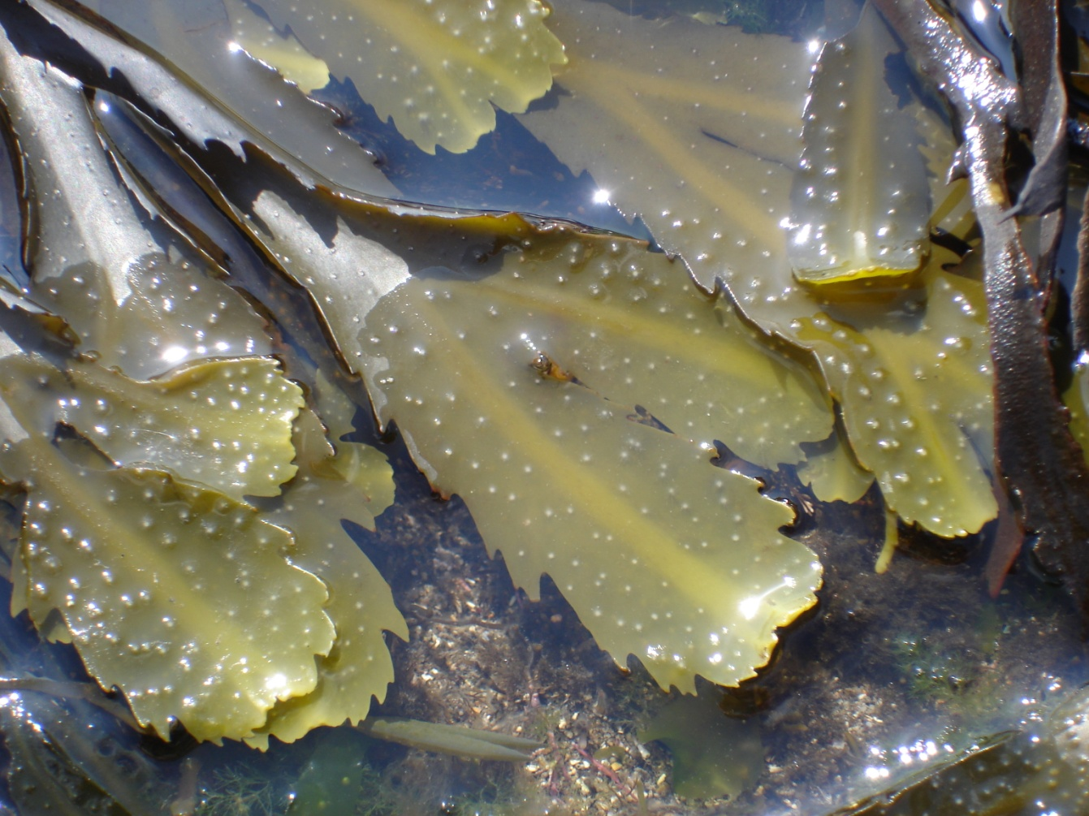
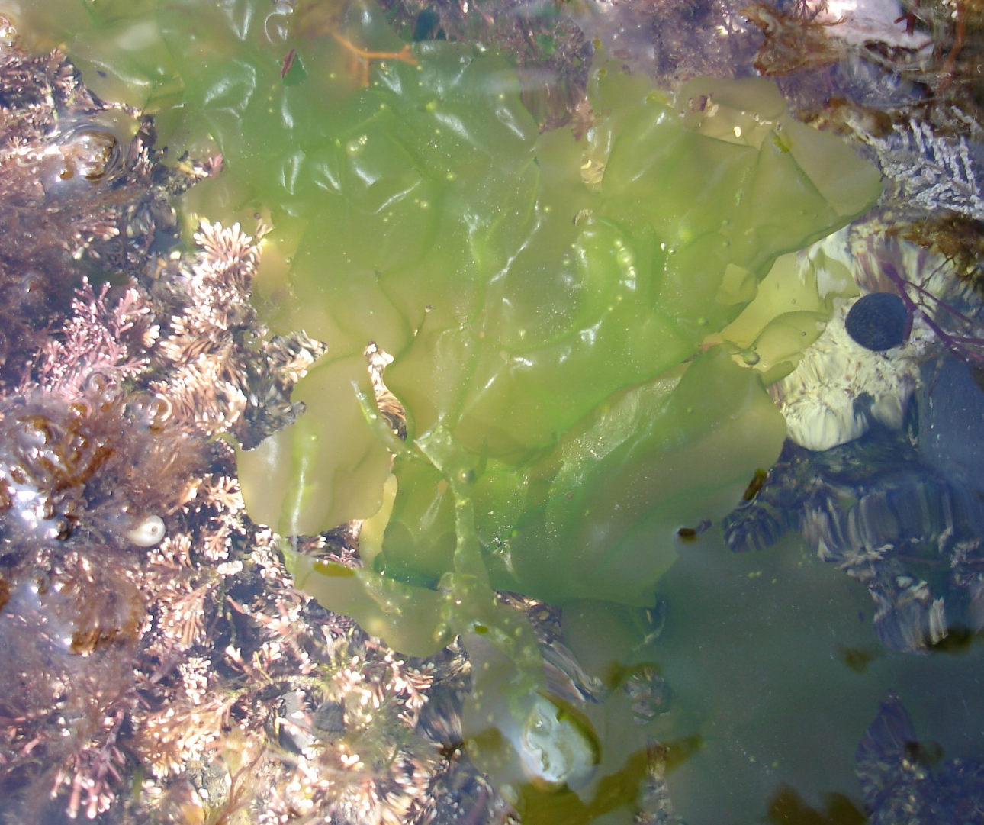
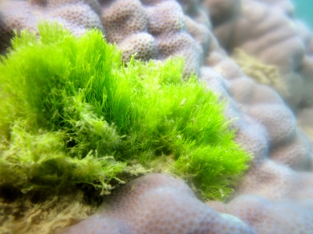
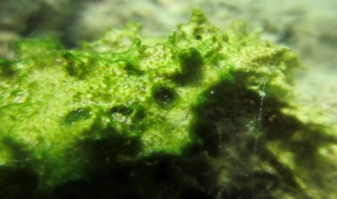
Macroalgae (seaweed)

Slide 16
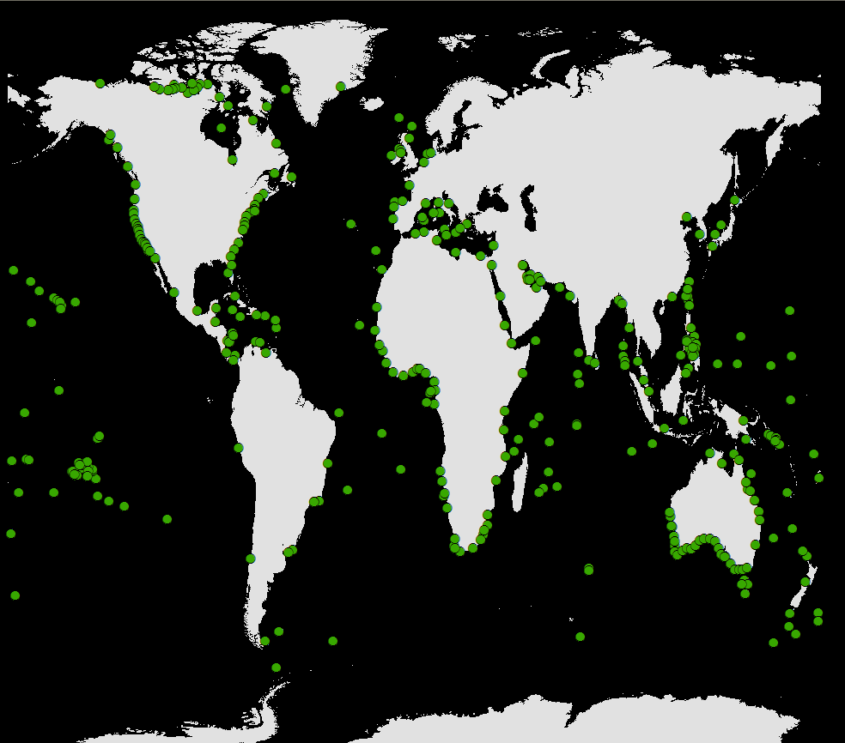
Macroalgal genus richness

Slide 17
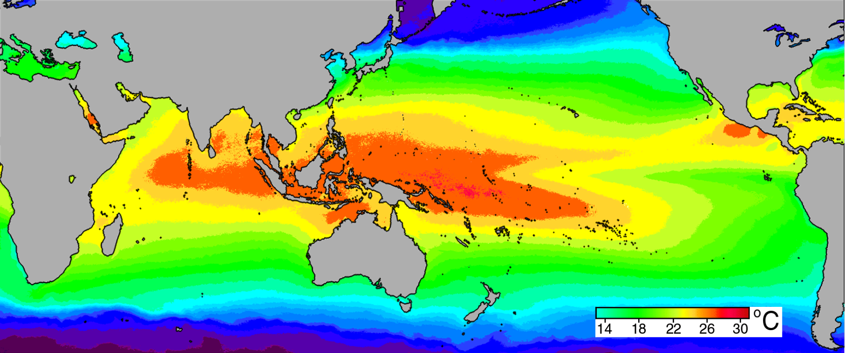
Variables
Macroalgae genus richness
SST = sea surface temperature
PAR = photosynthetically available radiation
PHOS = phosphate concentration
SALINITY = salinity concentration

Slide 18
Exercise 2
Data visualization
There are 2 points in this section where you need to produce plots to go into your report
############################################################
####### FOR YOUR REPORT 1 ######
####### START ######
############################################################
## ……..information on what you need to do…
############################################################
####### FOR YOUR REPORT 1 ######
####### END ######
############################################################

Slide 19
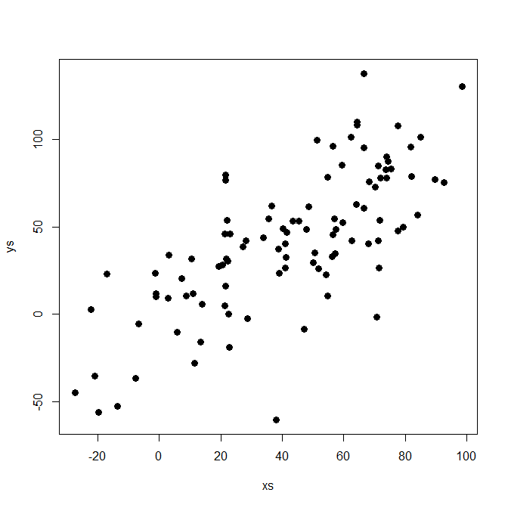
Linear regression reminder
Residual
Intercept
Coefficient (slope)

Slide 20
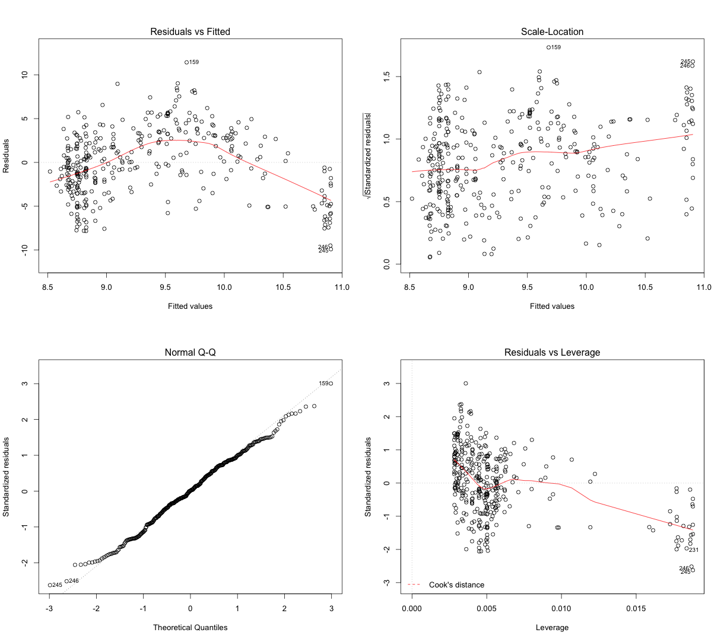
Linear regression diagnostics

Slide 21
Linear Regression output
Call:
lm(formula = Abundance ~ Rainfall, data = sp)
Residuals:
Min 1Q Median 3Q Max
-1.6552 -0.4614 -0.2550 -0.1743 3.9637
Coefficients:
Estimate Std. Error t value Pr(>|t|)
(Intercept) -6.19866 2.06222 -3.006 0.0063 **
Rainfall 0.46383 0.08546 10.108 6.24e-10 ***
---
Signif. codes: 0 ‘***’ 0.001 ‘**’ 0.01 ‘*’ 0.05 ‘.’ 0.1 ‘ ’ 1
Residual standard error: 1.429 on 23 degrees of freedom
Multiple R-squared: 0.8163, Adjusted R-squared: 0.2093
F-statistic: 102.2 on 1 and 23 DF, p-value: 0.3209

Slide 22
Exercise 3
Linear regression
There is 1 point in this section where you need to produce plots to go into your report
############################################################
####### FOR YOUR REPORT 4 ######
####### START ######
############################################################
## ……..information on what you need to do…
############################################################
####### FOR YOUR REPORT 4 ######
####### END ######
############################################################

Slide 23
Model selection
Global model call: lm(formula = sqrtGenusRich ~ SST.MEAN + PHOS, data = mgr, na.action = "na.fail")
---
Model selection table
(Int) PHO SST.MEA df logLik AICc delta weight
4 15.820 -6.060 -0.21810 4 -951.120 1910.4 0.00 1
3 10.910 -0.07695 3 -974.716 1955.5 45.15 0
2 9.958 -1.854 3 -976.311 1958.7 48.34 0
1 9.334 2 -979.992 1964.0 53.66 0

